Slide 1
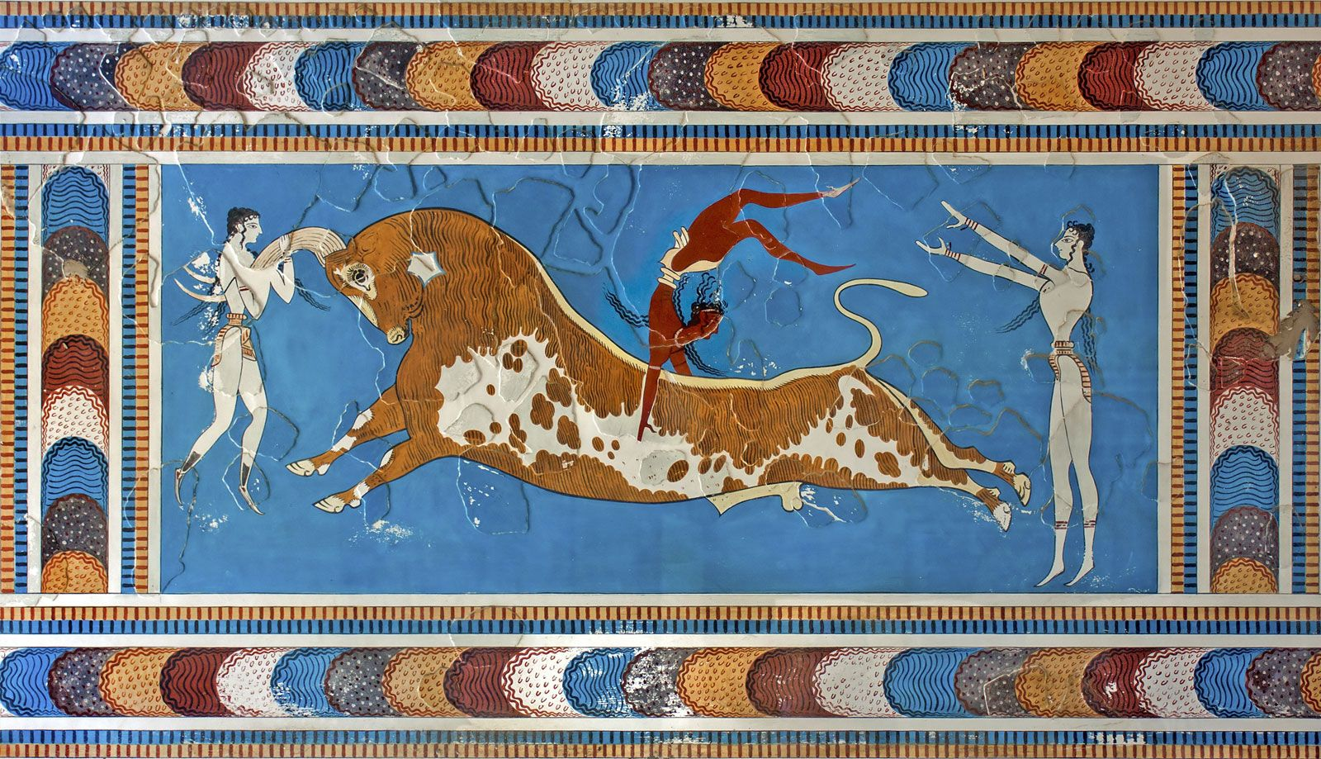
The Minoans
Goal/s:
Identify the key features of the Minoans
Describe the myth of the minotaur
Week 2 Lesson 1
Ms Barrie

Slide 2
Today’s Lesson
- Overview of the Minoan Civilisation
- Discuss/Describe the myth of the Minotaur and significance of the bull

Slide 3
The Minoans
https://study.com/academy/lesson/minoan-civilization-facts-map-timeline.html#:~:text=The%20Minoans%20were%20a%20group,son%20of%20Zeus%20and%20Europa.
Watch the following video – minoan overview

Slide 4
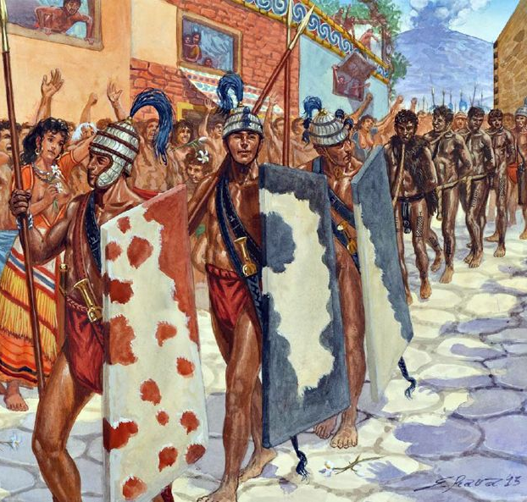
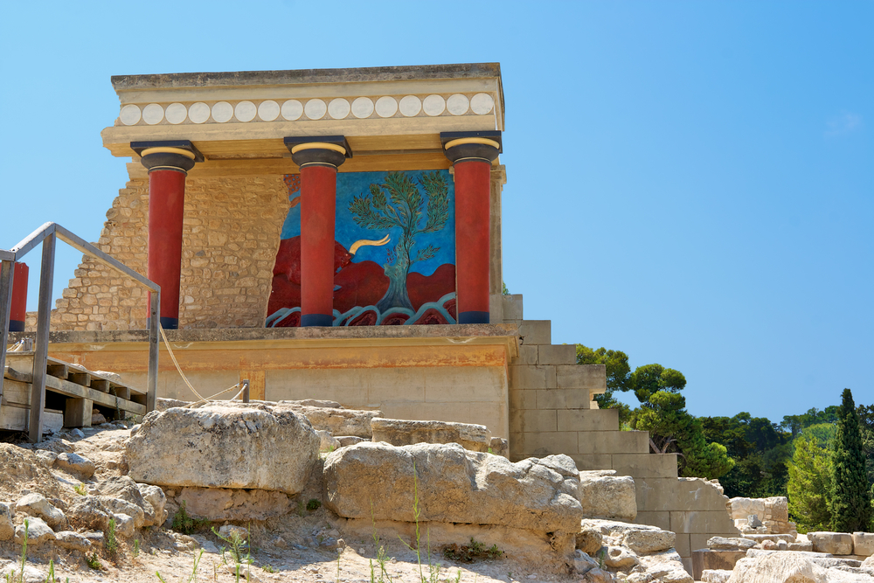
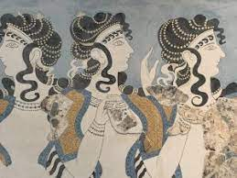
Looking at these images, what assumptions can you make about the Minoan Civilization?

Slide 5
The Minoans
KEY INFO
c. 2100 BCE to 1100BCE
Bronze Age
Island of Crete
Knossos Palace
Linear A Language
Significance of bull
Knowledge of this civilidation’s existence was lost until the 20th century when excavations by British archaeologist Sir Arthur Evans revealed the palace at Knossos.

Slide 6
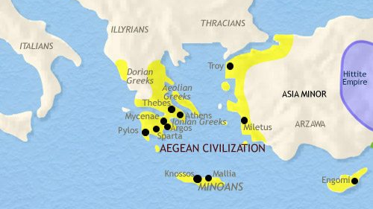
Minoan Civilisation – Location

Slide 7

Important Note:
The Minoans wouldn't have called themselves Minoans, however. The term comes from Sir Arthur Evans who, upon finding that the palace at Knossos was labyrinth-like and, after excavating many examples of artwork depicting bulls, was reminded of the Ancient Greek myth of Theseus, King Minos, and the Minotaur (a half-bull, half-man who lived in a labyrinth under the palace of Minos).
This suggests that when the myth was created in Greece (probably several hundred years later) it was actually referencing a real historical society as the foundation of the story.

Slide 8
Key questions – Who were they and what happened to them?
The Minoans were a sea-trading people who developed a civilization on the island of Crete in the Mediterranean Sea during the Bronze Age. The Minoan Civilization came to an end when Crete was invaded by the Mycenaeans.

Slide 9
Key questions – What were they known for?
The Minoan Civilization was a sea-trading society that developed complex palace structures and fine art in the form of pottery and wall frescoes that ultimately influenced the art in other Mediterranean societies.

Slide 10
Key questions – When did it end?
The Minoan Civilization came to an end around 1100 B.C.E. when the Mycenaeans, a civilization from southern Greece, took control of the island of Crete.

Slide 11
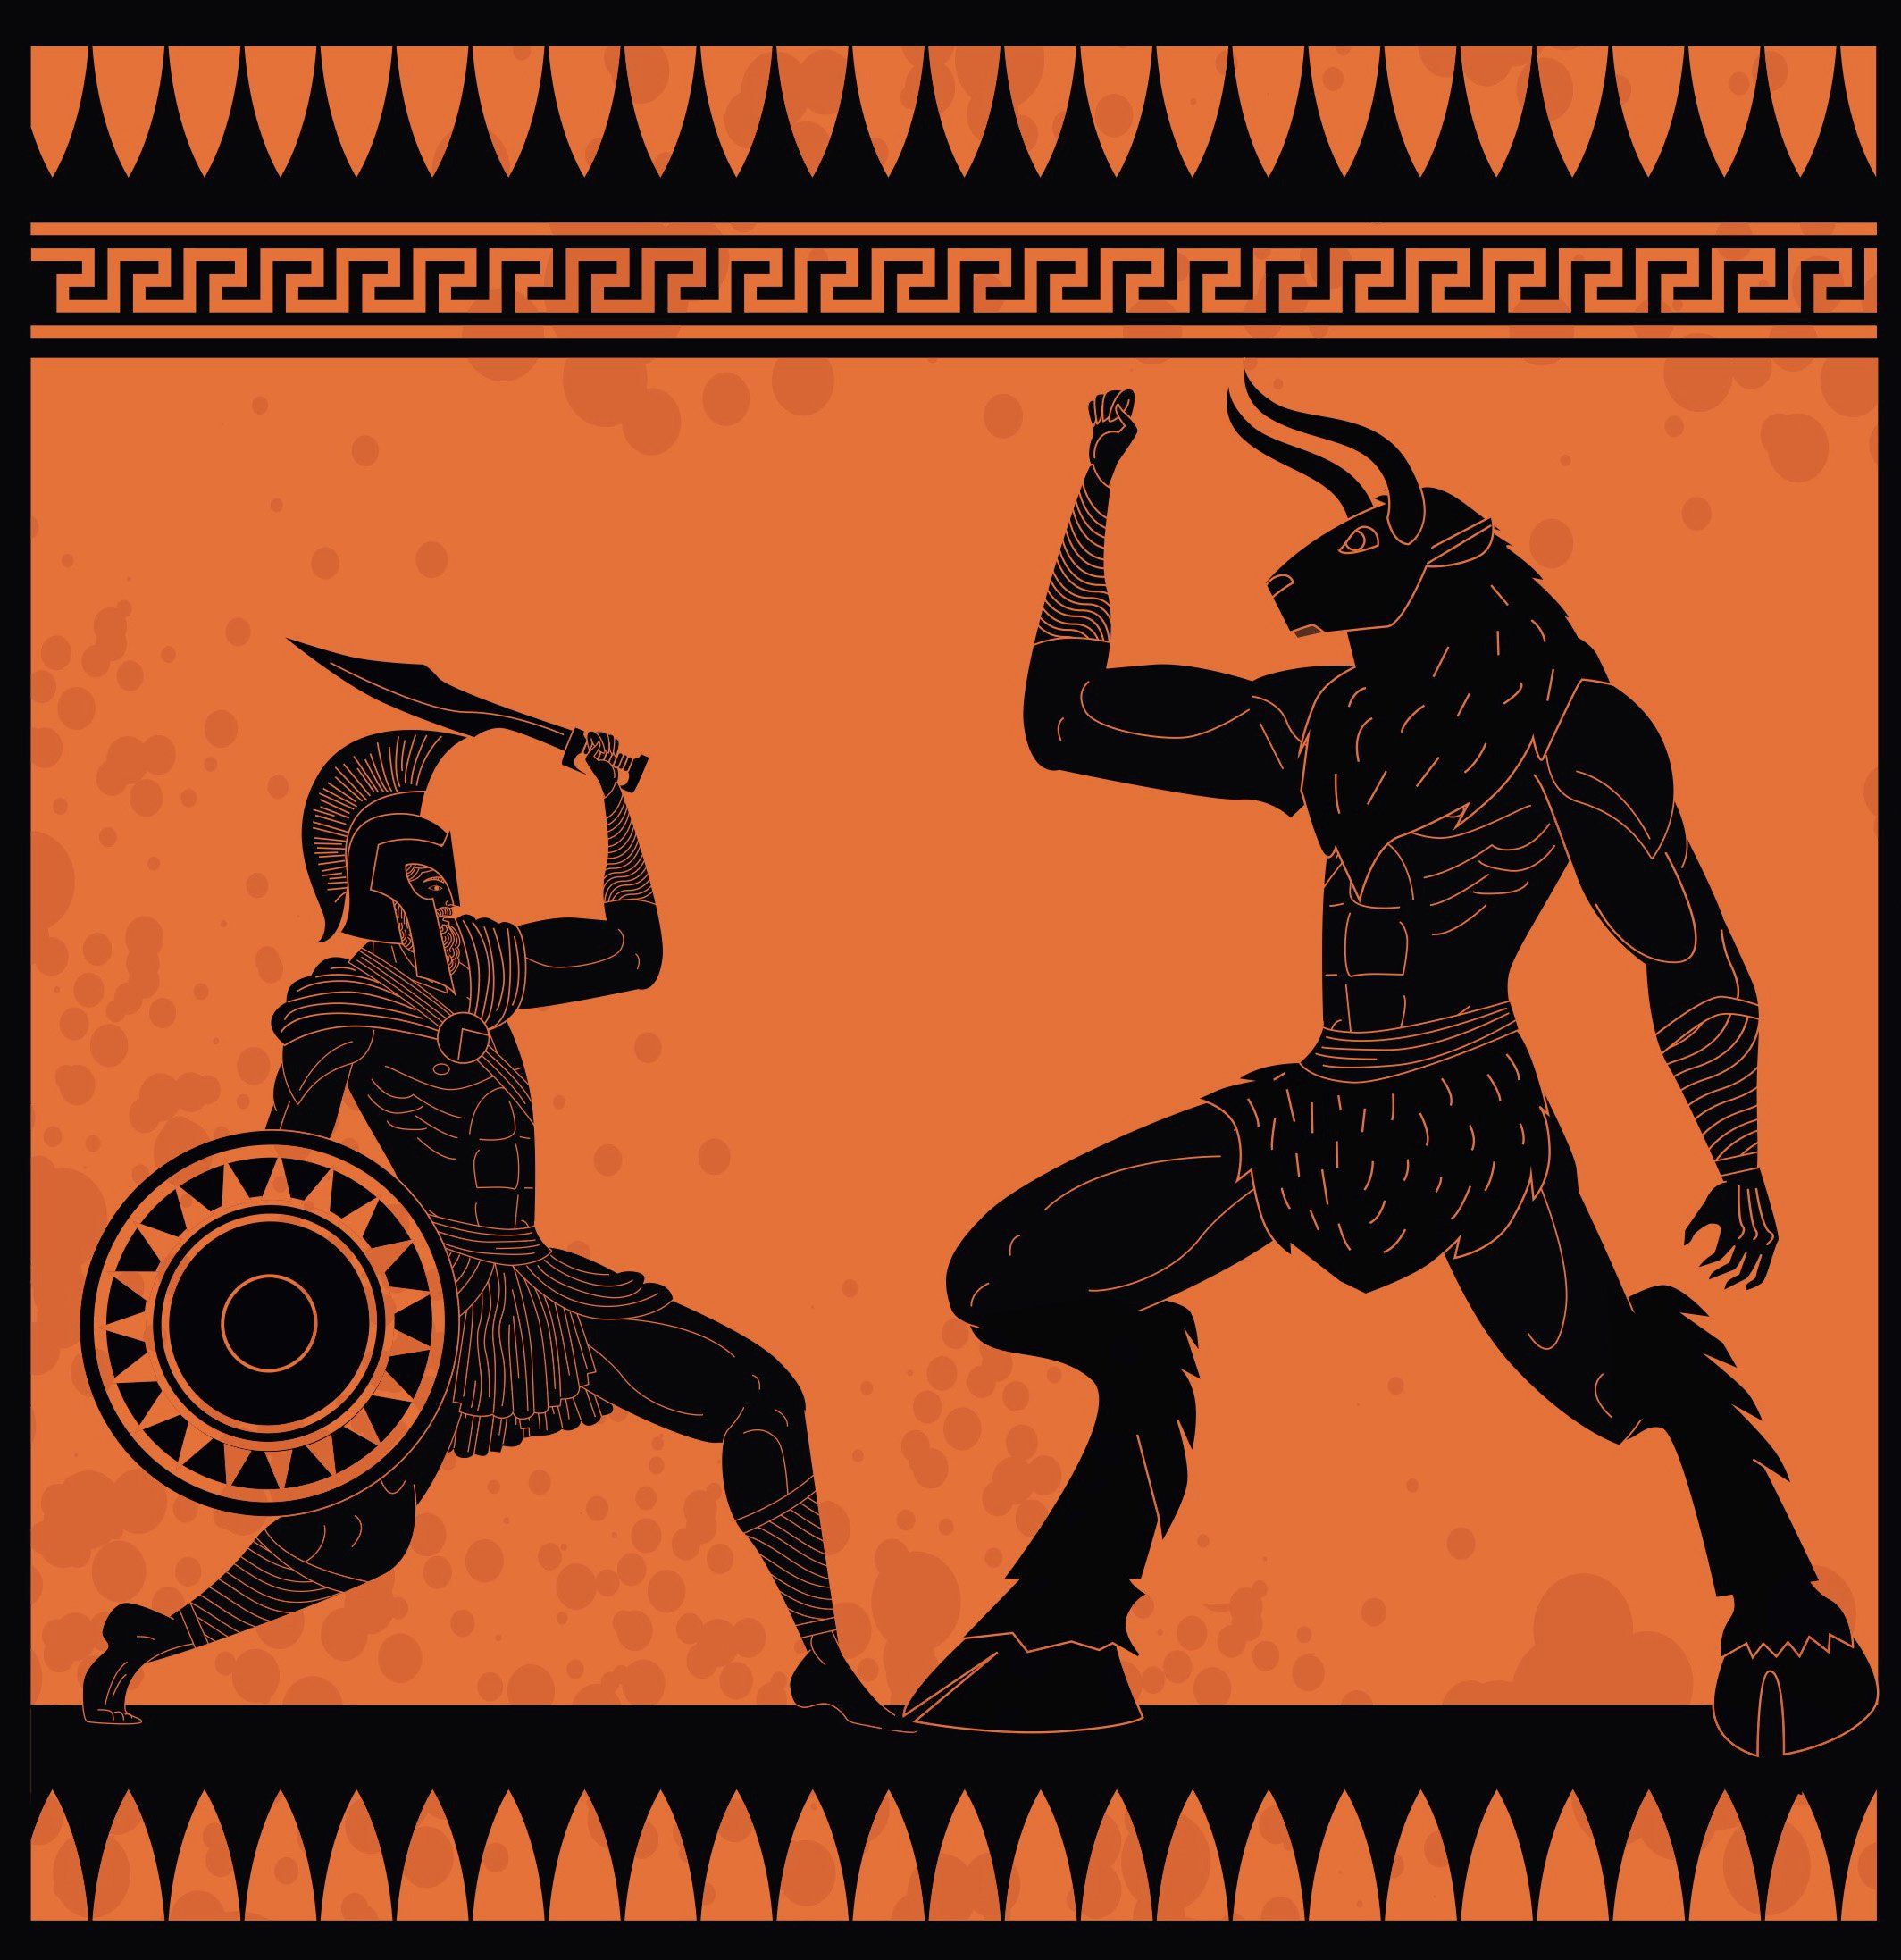
The myth of the Minotaur
What do you already know?

Slide 12
CARD SORT ACTIVITY – The myth of the Minotaur
In groups or pairs, sort the cards to create the story of the Myth of the minotaur.
Create a comic strip/story board of the events of the story.

